Slide 1

Sustainable Crop Yield Prediction
via Multi-modal AI: Robustness under Modality Degradation
MSc Dissertation Project Report
By Dipanjan Das (202441750)
MSc Artificial Intelligence, University of Hull

Slide 2

The Challenge: Modality Degradation
Fragility of Current AI
Modern Agricultural AI relies heavily on Earth Observation (EO) data. However, real-world deployment faces severe limitations:
Optical Satellites (Sentinel-2): Frequently obstructed by cloud cover, rendering spatial data useless.
Meteorological Models: Lack spatial granularity to capture localized crop stress.
Naive Fusion: Standard models (early/late fusion) fail catastrophically when forced to digest noise from corrupted modalities.

Slide 3






Aims & Objectives
Aim: Develop and evaluate a Gated Multimodal Deep Learning (GMU) architecture that dynamically adapts to missing or corrupted input modalities for US soybean yield prediction.
Baselines
Architecture
Stress Testing
Establish performance floors using Unimodal (Weather-only, Satellite-only) and Static Fusion models.
Engineer a GMU to calculate dense attention weights, dynamically adjusting modality importance.
Quantify network resilience under simulated sensor failure and cloud occlusion (up to 75% corruption).

Slide 4
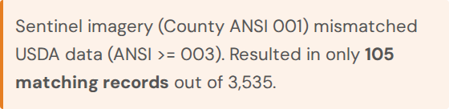
Data Scope & Infrastructural Gap
The CropNet Benchmark (2016-2022)
•
Target: USDA NASS Soybean Yield (BU/ACRE).
•
Temporal: HRRR Meteorological Tensors (Bi-LSTM).
•
Spatial: Sentinel-2 Multispectral Imagery (CNN).
The FIPS Alignment Risk
A profound infrastructural mismatch was discovered:

Slide 5

Statistical Target Transformation
10.74 Standard Deviation (BU/ACRE)
Jensen's Bias Correction
Due to the convexity of the exponential function, inverse transformation systematically underestimates yield.
Raw USDA yield data showed massive inter-annual volatility and non-normality (Shapiro-Wilk W=0.9675, p=0.0000).
Solution: Log-transformation of the target variable for SGD optimization.
Applied during inference to ensure outputs are physically readable and accurate.

Slide 6


The Gated Multimodal Unit (GMU)
Deep feature-level fusion replacing static algebraic averaging with adaptive mathematical gating.
Encoders
Dynamic Gating Logic
Weather: Bi-LSTM
Satellite: CNN
The gate scalar dynamically routes predictions based on input reliability.

Slide 7
Results: Model Benchmarking
Evaluation on LOSO 2022 state-aggregate holdout.
Architecture Configuration | RMSE (BU/ACRE) | R²
Satellite-Only (CNN) | 11.044 | -2.904
Late Fusion (α-Blend) | 5.763 | 0.612
Weather-Only (Bi-LSTM) | 5.763 | 0.612
Early Fusion (Concat) | 5.578 | 0.637
Gated Multimodal Unit (GMU) | 5.562 | 0.639
Diagnostic Insight: Late Fusion collapsed to the Weather-only baseline (assigned 0% weight to satellite), proving it cannot recover from a weak encoder.

Slide 8
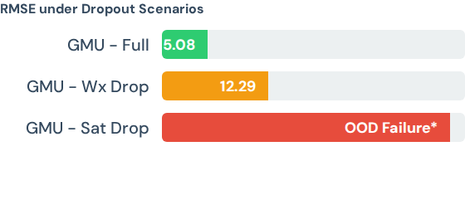
Operational Resilience (Stress Testing)
Modality Dropout Matrix
The GMU was subjected to simulated sensor failures. A key finding was the autonomous gate shift:
Normal (Full): Mean = 0.575 (Balanced)
*Complete satellite removal produced extreme OOD embeddings, indicating a need for a binary availability safeguard at deployment.
Satellite Drop: shifts to 0.621 (Routes towards Weather)
When severe cloud occlusion occurred, plummeted to 0.08, successfully routing 92% of predictive logic through the uncorrupted weather pathway.

Slide 9




Explainable AI & Algorithmic Fairness
SHAP Validation
Geographic Bias Audit
SHAP KernelExplainer extracted feature importance, confirming the network prioritized critical biological drivers like Vapor Pressure Deficit and Max Temperature in mid-summer, aligning with agronomic reality.
The model hyper-optimized for the Corn Belt. Max/min RMSE ratio across states was 32.95x. Marginal states suffered higher errors, mandating equity-weighted loss functions for fair deployment.

Slide 10
Conclusions & Recommendations
GMU Superiority: Deep feature-level fusion with adaptive gating outperforms naive static fusion, providing crucial resilience against non-stationary noise.
Infrastructure Bottleneck: The FIPS alignment gap between Sentinel and USDA databases is the primary barrier to continental-scale deployment, not algorithmic design.
Deployment Safeguards: Real-world systems require binary satellite availability checks to prevent OOD failure cascades.
Ethical AI: Geographic cross-validation error weighting is imperative to prevent systemic disenfranchisement of marginal farming regions.

